Slide 1
Progresivne Web Aplikacije Što, kako, zašto
Andrej Matijević

Slide 2
Progressive Web App

Slide 3
Progressive Web Site

Slide 4
“Web as native” is not a new concept

Slide 5
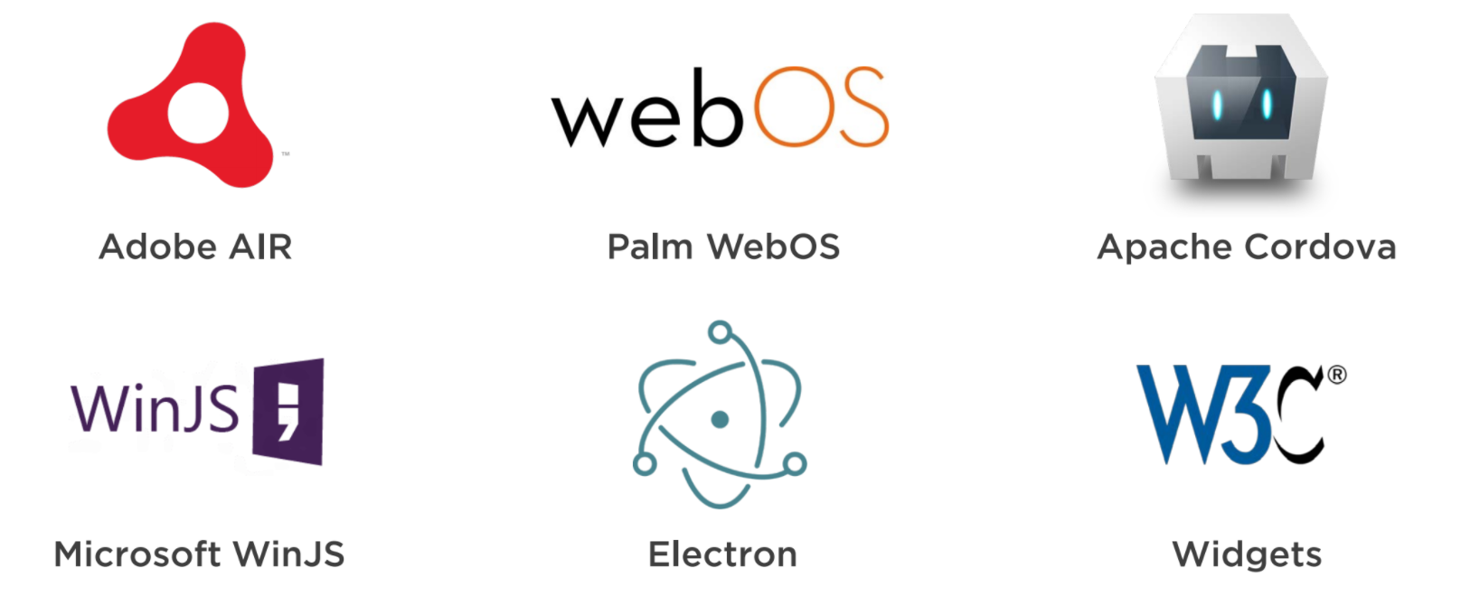

Slide 6
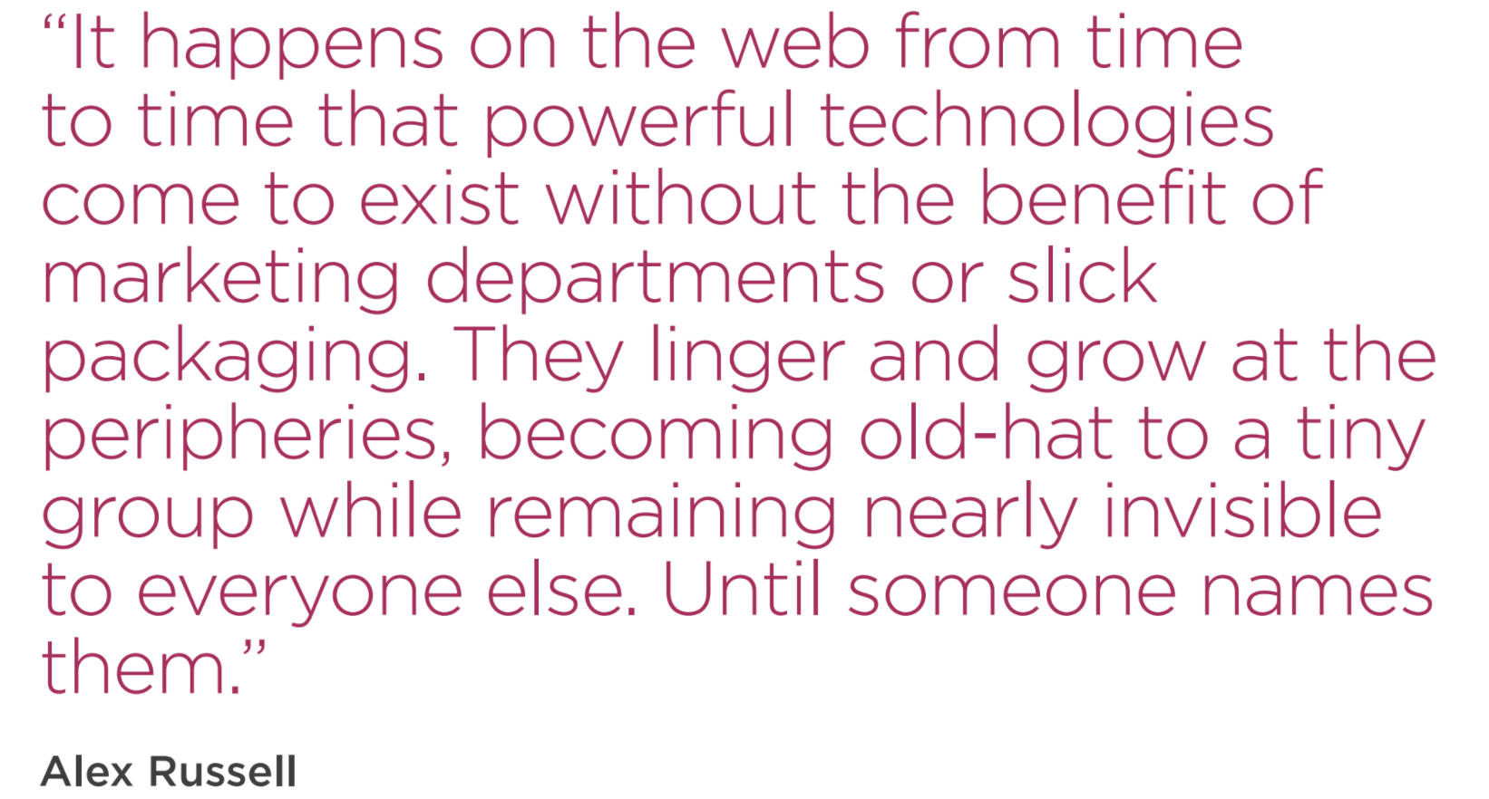

Slide 7
A PWA is

Slide 8
A PWA is
Progressive

Slide 9
A PWA is
Progressive
Responsive

Slide 10
A PWA is
Progressive
Responsive
Network Independent

Slide 11
A PWA is
Progressive
Responsive
Network Independent
App-Like

Slide 12
A PWA is
Progressive
Responsive
Network Independent
App-Like
Fresh

Slide 13
A PWA is
Progressive
Responsive
Network Independent
App-Like
Fresh
Safe

Slide 14
A PWA is
Progressive
Responsive
Network Independent
App-Like
Fresh
Safe
Discoverable

Slide 15
A PWA is
Progressive
Responsive
Network Independent
App-Like
Fresh
Safe
Discoverable
Re-engageable

Slide 16
A PWA is
Progressive
Responsive
Network Independent
App-Like
Fresh
Safe
Discoverable
Re-engageable
Installable

Slide 17
A PWA is
Progressive
Responsive
Network Independent
App-Like
Fresh
Safe
Discoverable
Re-engageable
Installable
Linkable

Slide 18
PWA or Native?
It depends.

Slide 19
PWAs = Lower Cost (& Time) to Build
Native App store submission is largely required
App core
Web
Host
iPhone
iPad
Submit to App Store
Android Phone
Android Tablet
Submit to Play Store
Windows
Submit to Windows Store
MacOS
Submit to Mac App Store

Slide 20
PWAs = Lower Cost (& Time) to Build
Native App store submission is largely required
PWA App store submission optional (or one-time)
App core
App core
Web
Host
Web
Host
iPhone
iPad
Submit to App Store
Android Phone
Android Tablet
Submit to Play Store
iPhone
iPad
Free
Windows
Submit to Windows Store
Android Phone
Android Tablet
MacOS
Submit to Mac App Store
Windows
MacOS
Other PWA-capable

Slide 21
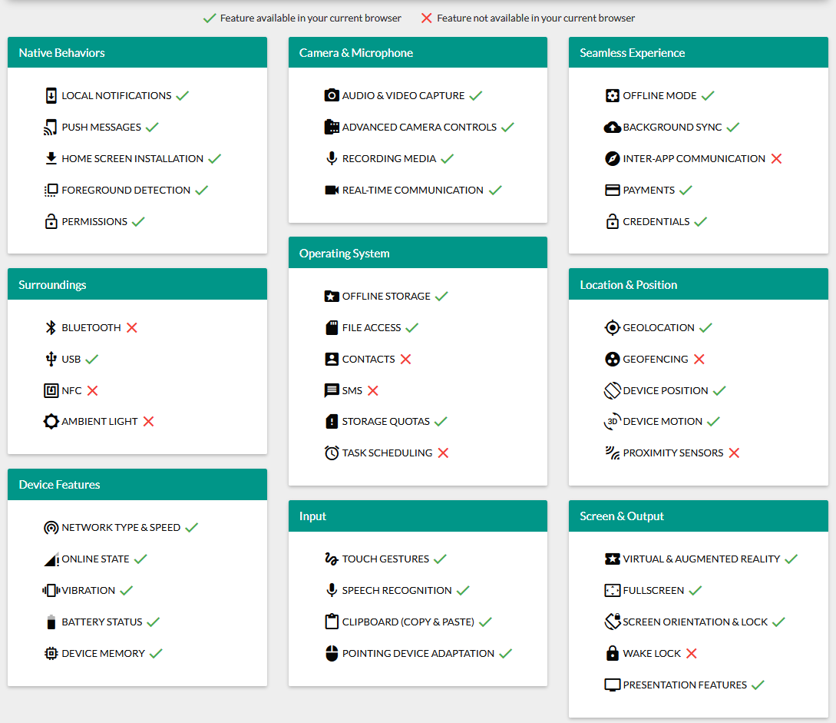
whatwebcando.today

Slide 22
Demo
Site is served over HTTPS
Pages are responsive on tablets and mobile devices
Metadata is provided for add to home screen
The start url loads while offline
First load fast even on 3G
Site work cross-browser *
Page transition don’t feel like they block on the network
Each page has URL

Slide 23
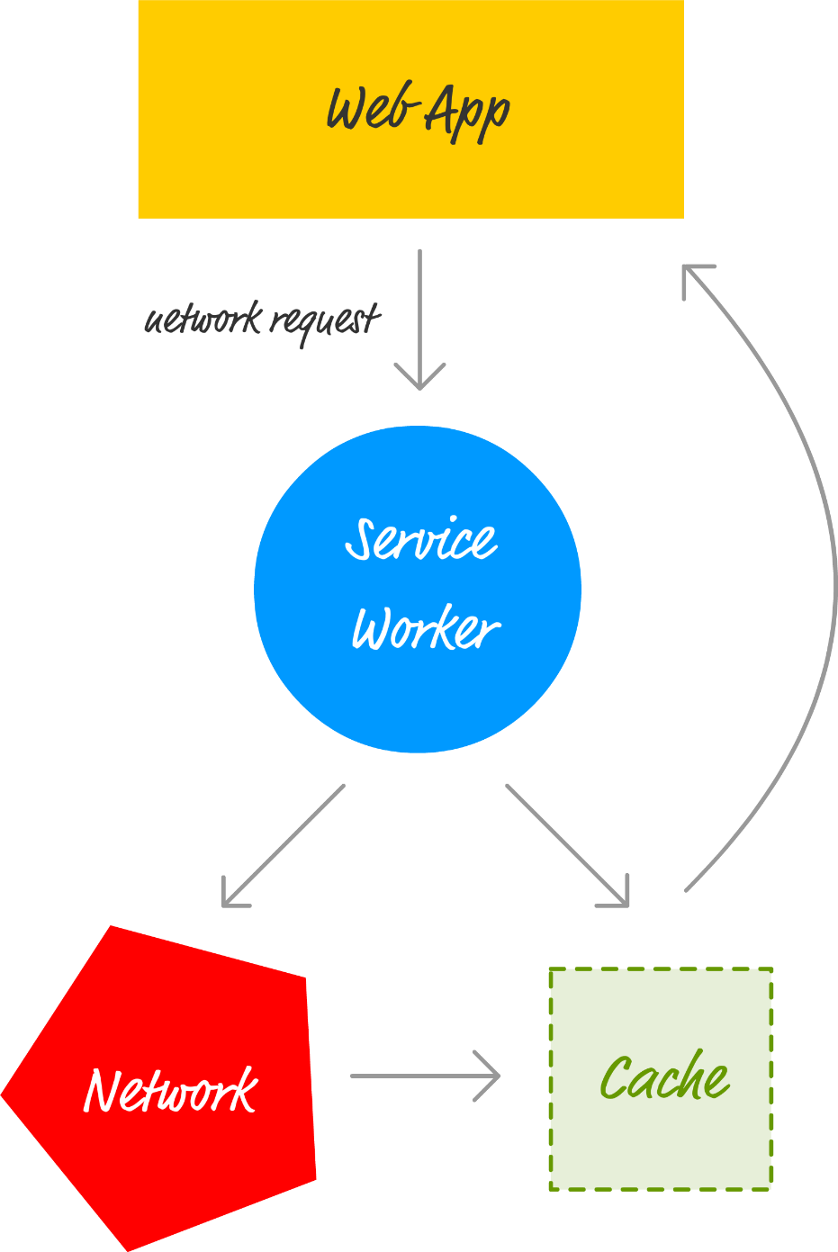
Service Worker Act as proxy servers that sit between web apps, the browser, and the network (when available).

Slide 24
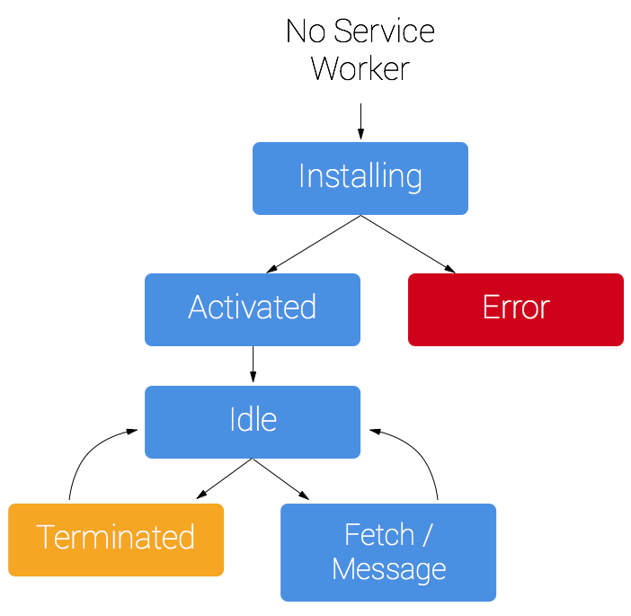
Service Worker Life cycle

Slide 25
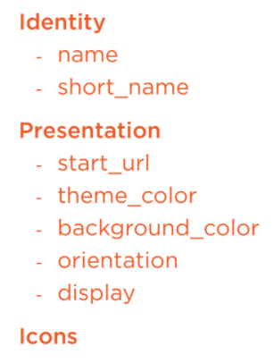
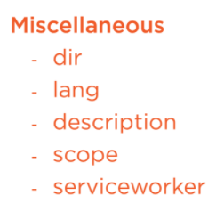
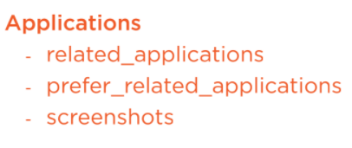
Web app Manifest JSON file

Slide 26
Deploy - HTTPS

Slide 27
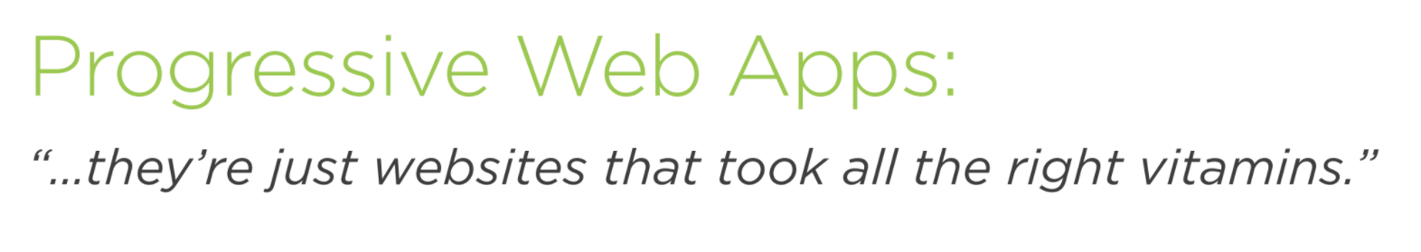

Slide 28
Hvala

